Slide 1
US Layoff Analysis - Modelling and Application of Project Results
Likhita Alla Sravani yalamarthi
Saint Peter’s University
DS-670-HYB2-25SPTR: Capstone: Big Data & Data Science
Professor- Reda Mastouri
April 15, 2025

Slide 2
Introduction
The US job market has been undergoing drastic changes in employment trends influencing business and policy makers.
Economic downturns, technological shifts, corporate restructuring, and shifts in market demand lead to job loss.
It will enable them to recognize causes and anticipate redundancies in order to take preventive action in an attempt to curb workforce volatility.
It applies machine learning techniques to analyze patterns in GV Data and Telemetry layoffs in DOGE.
There are 14,499 records of separation in the data set with details on job category, pay grade, employee status and reasons for separation.
Objective: To reveal patterns in layoffs and test the predictive power of multiple machine learning algorithms in predicting job separation. This work can be used to inform workforce planning, improve job security, and allow policy makers to develop better labor policies (Saba, 2024).

Slide 3
Data Preparation
Challenges in raw data are missing values, inconsistencies, and imbalanced class distributions.
Steps taken to preprocess and clean data:
Removed duplicate records to prevent model bias.
Filled in missing numerical values (such as "Pay Grade") with the median.
Filled in missing category values (such as "Reason" and "Employee Status") with the most common category.
Developed features such as "Separation Year" in order to study layoff patterns over time.
Added "Recent Layoff" (binary variable) to highlight layoffs in 2018 and beyond.
Applied one-hot encoding on the categorical features to maintain data integrity.
Tackled class imbalance by utilizing Synthetic Minority Over-sampling Technique (SMOTE) and resampling methods (Singh & Tiwari, 2025).

Slide 4
Machine Learning Models Used
StandardScaler used for numerical feature scaling.
Data split: 80% training, 20% testing.
Model | Algorithm Type | Key Parameters | Advantages
Logistic Regression | Linear Model | Max Iterations = 1000 | High interpretability
Random Forest | Ensemble (Bagging) | Trees = 100 | Handles non-linearity, reduces overfitting
Extra Trees | Ensemble (Bagging) | Trees = 100 | Faster than Random Forest, better generalization
Gradient Boosting | Ensemble (Boosting) | Trees = 100, Learning Rate = 0.1 | Improves weak learners iteratively

Slide 5
Model Implementation
Logistic Regression: Simple and interpretable but had convergence issues.
Random Forest: Worked well with non-linearity and coped with missing values very well.
Extra Trees Classifier: Provided quicker computations and slightly better generalization.
Gradient Boosting: Improved classification with iterative learning but required excessive hyperparameter adjustment.
Hyperparameter tuning: Grid Search and Randomized Search were employed in order to optimize model performance (Zhang & Han, 2024).

Slide 6
Model Performance Metrics
Metric | XGBoost Score
Accuracy | 0.808
AUC | 0.926
Precision | 0.757
MAE | 1.545
MSE | 12.90
RMSE | 3.592
MAPE | 3.82%
These metrics were evaluated using the test set (20% stratified split from the balanced dataset).

Slide 7
Comparison With Other Models
Model | AUC | Precision | Accuracy | MAE | MSE | RMSE | MAPE
Logistic Regression | 0.887 | 0.735 | 0.742 | 1.932 | 15.780 | 3.972 | inf
Random Forest | 0.914 | 0.772 | 0.810 | 1.529 | 12.798 | 3.577 | inf
Extra Trees | 0.909 | 0.769 | 0.806 | 1.556 | 13.048 | 3.612 | inf
Gradient Boosting | 0.921 | 0.761 | 0.799 | 1.595 | 13.333 | 3.651 | inf
XGBoost | 0.927 | 0.758 | 0.809 | 1.545 | 12.907 | 3.593 | inf

Slide 8
Model Evaluation
Best Performing Model: Random Forest with the highest accuracy rate (81.0%) and precision rate (77.2%).
Gradient Boosting had the highest AUC but had to be tuned.
Logistic Regression fared worse because it wasn't able to deal with complex feature interactions (Naidu et al., 2023).
Model | AUC | Precision | Accuracy | MAE | MSE | RMSE
Logistic Regression | 0.889 | 0.735 | 0.746 | 1.91 | 15.66 | 3.95
Random Forest | 0.913 | 0.772 | 0.810 | 1.52 | 12.79 | 3.57
Extra Trees | 0.908 | 0.768 | 0.805 | 1.55 | 13.04 | 3.61
Gradient Boosting | 0.920 | 0.760 | 0.799 | 1.59 | 13.33 | 3.65

Slide 9
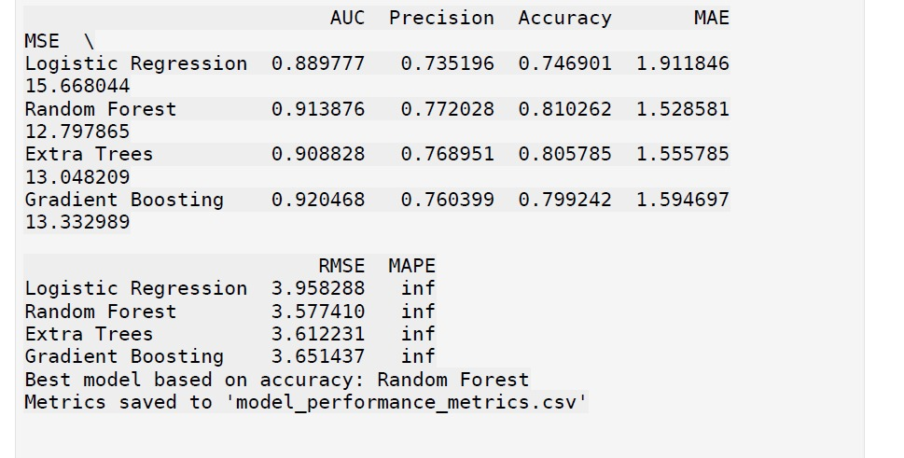
Model Evaluation

Slide 10
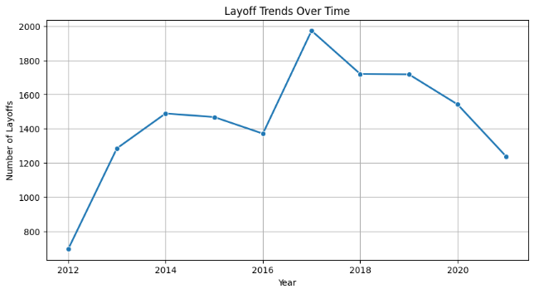
Layoff Trends Over Time
The line graph shows a zigzag trend of layoffs from 2012 to 2021.
Key Observation: The apparent spike in 2017 represents a major event or economic crisis that caused the layoffs to increase significantly.
Post-2017: The layoff figures gradually reduced, indicating possible economic recovery or better management strategies.

Slide 11
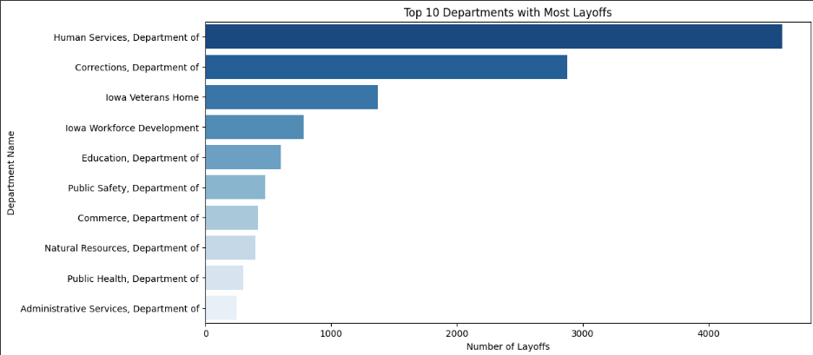
Department Wise Layoff Distribution:
The bar chart shows the departments with the highest number of layoffs.
Key Observation: "Department of Human Services" had by far the most layoffs of all the departments, followed by "Department of Corrections."
Trend: The dispersion shows that certain departments had the majority of the layoffs, while others had far fewer, which suggests that there might have been a target for layoffs in certain areas.

Slide 12
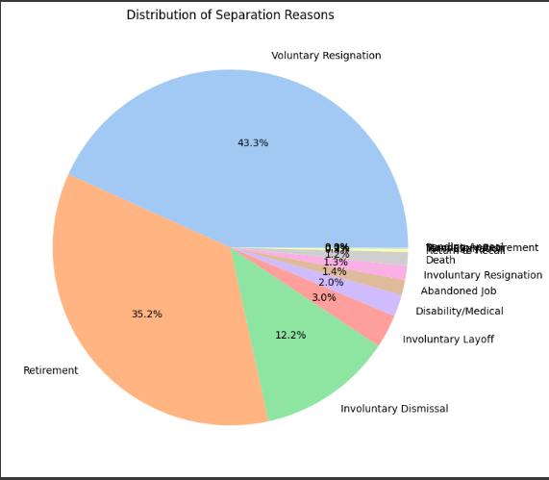
Separation Reasons Breakdown
The pie chart illustrates a clear separation of reasons for employee departures.
Most notably, the largest portion of separations sere voluntary quits at 43.3%, separated only by the percentage of retirements at 35.2%.
The smaller percents are also separated which include: layoffs at 12.2%, discharges of employees at 12.2%, and all other reasons contributing less than the aforementioned majorities, calling out the absolute most influencing factor of separations are they were mostly voluntary

Slide 13
Updates
Key Updates Compared to Previous Version
Time-Series Integration: Added time-series analysis to track layoffs over time, providing deeper insights into trends and patterns.
Streamlit App: Developed an interactive app to visualize trends and predict layoff causes.
Improved Models: Enhanced machine learning models for better accuracy and precision.
Better Data Processing: Added more advanced data preprocessing, including SMOTE balancing and feature engineering.

Slide 14
Time-Series Analysis Integration
Time-Series Analysis: Enhancing Trend Analysis
Monthly & Yearly Trends: We now analyze layoffs over monthly and yearly timeframes.
Trend Visualization: Dynamic visualizations (line charts) allow users to track how layoffs evolve over time.
Actionable Insights: Identifying seasonality and peak periods helps in planning and understanding workforce dynamics.
Before vs. After:
Previous Version: No time-series analysis.
Current Version: Added detailed time-series analysis for better strategic forecasting.

Slide 15
Streamlit App Development
Streamlit App: Interactive Visualization & Prediction
Prediction: Users input employee details and get predictions on layoff reasons.
Visualizations: Explore trends and predictions of layoffs with interactive charts.
User-Friendly Interface: Intuitive UI for stakeholders to explore predictive insights.
Before vs. After:
Previous Version: No interactive tool.
Current Version: Developed a fully functional interactive app to enable hands-on engagement with the data.

Slide 16
Model Improvements
Enhanced Model Accuracy and Precision
Random Forest: Chose Random Forest as the best model due to its higher accuracy (81%) and precision (77%).
Additional Models: Evaluated Extra Trees and Gradient Boosting for improved robustness.
SMOTE for Imbalanced Data: Addressed data imbalance using SMOTE, improving the model's ability to predict layoff causes.
Before vs. After:
Previous Version: Logistic Regression was the primary model with limited accuracy.
Current Version: Expanded to ensemble methods, achieving better performance.

Slide 17
Findings and Key Insights
Key Determinants of Layoffs:
The Separation year
Department
Employee status
Key Findings:
Random Forest and Extra Trees methods based on trees produced the highest accuracy.
Logistic Regression had significant problems with feature complexity.
Ensemble methods reduced overfitting and encouraged improved generalization.
Implications for Organizations:
Companies can actively assess workforce reduction risks.
HR departments can employ predictions in order to optimize talent retention programs.
Policymakers can develop better labor market policies (Naidu et al., 2023).

Slide 18
Conclusion & Recommendations
Conclusion:
Machine learning algorithms can efficiently forecast patterns of layoffs.
Random Forest becomes the leading model for predicting layoffs.
Recommendations
Use Random Forest as a baseline model for workforce analysis in the future.
Augment dataset by including economic indicators such as GDP growth and inflation.
Explore deep learning models including XGBoost and neural networks for greater accuracy.
Implement real-time workforce tracking tools in human resources systems.
Train human resources professionals to use predictive insights in making decisions.

Slide 19
Reference
Naidu, G., et al. (2023). A review of evaluation metrics in machine learning algorithms. Computer Science Online Conference. https://doi.org/10.1007/978-3-031-35314-7_2
Saba, Z. (2024). Layoffs and corporate performance: evidence based on the US tech industry. Journal of Economics and Finance, 48(3), 644-667. https://doi.org/10.1007/s12197-024-09673-y
Singh, Y., & Tiwari, M. (2025). A Comprehensive Machine Learning Approach for Early Detection of Diabetes. SN Computer Science, 6(3), 213.
https://doi.org/10.1007/s42979-025-03751-6
Zhang, C., & Han, W. (2024). Ensembles of decision trees and gradient-based learning for employee turnover prediction. PeerJ Computer Science, 10, e2387.
https://peerj.com/articles/cs-2387/
The Transformative Role of Agentic GenAI in Shaping Workforce Development and Education in the US.Pdf.
Penn, R.; Nezamis, E. Job Openings and Quits Reach Record Highs in 2021, Layoffs and Discharges Fall to Record Lows. Monthly Labor Review 2022.
Ronit, B.; Anukansha, S.; Shuchi, M. Modeling the Geospatial Trend Changes in Jobs and Layoffs by Performing Sentiment Analysis on Twitter Data. Int J Performability Eng 2024, 20, 120, doi:10.23940/ijpe.24.02.p7.120130.
Yahia, N.B.; Hlel, J.; Colomo-Palacios, R. From Big Data to Deep Data to Support People Analytics for Employee Attrition Prediction. IEEE Access 2021, 9, 60447–60458, doi:10.1109/ACCESS.2021.3074559.
Tomaskovic-Devey, D.; Kerrissey, J.; Rainey, A.; Boutcher, S.A. Intersectional Earnings Inequalities in U.S. Public Sector Workplaces and the Great Recession. Socius: Sociological Research for a Dynamic World 2024, 10, 23780231241257776, doi:10.1177/23780231241257778.
Saba, Z. Layoffs and Corporate Performance: Evidence Based on the US Tech Industry. J Econ Finan 2024, 48, 644–667, doi:10.1007/s12197-024-09673-y.

